Slide 1

Enhanced Rolling Horizon Evolution Algorithm With Opponent Model Learning: Results for the Fighting Game AI Competition
Kyle Keener
IS 369
Prof. Ryan

Slide 2
Why this article?
Research into the advancement in ANN
Important development of more sophisticated opponent AI
Fascinating look into the development of real-time decision making
Documentation for decision-making algorithms

Slide 3
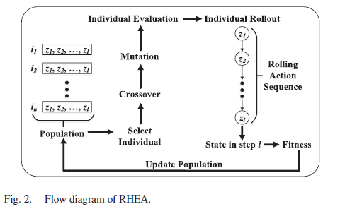
Themes
Increase in interest in developing AI for competitive, zero-sum games
Widely researched previously in turn-based games
Monte Carlo Tree Search
Combined with Deep reinforcement learning (DRL)
Require large number of iterations
Limited application to real-time decision making
Rolling Horizon Evolution Algorithm (RHEA) [Fig. 2]
Lower computational overhead
Better memory of preferred actions
Apply opponent selection
Fighting Game AI Competition

Slide 4
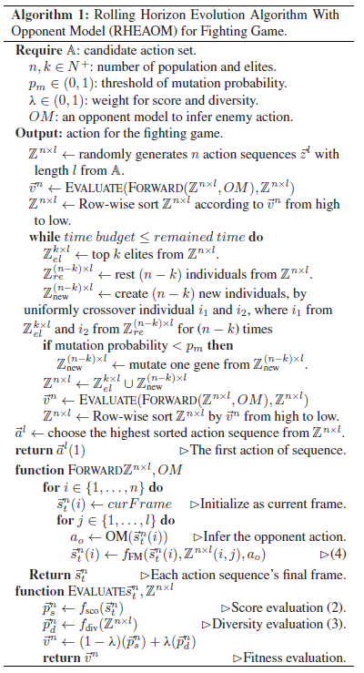
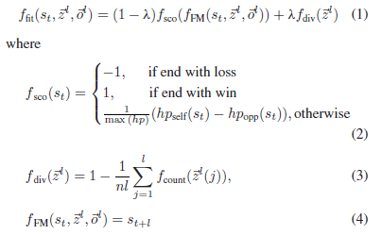
Methodology: RHEA
RHEA
Optimization process
Evolves action sequences through forward model
Population of action sequences
Calculate fitness, diversity, score, action sequence, forward model
Top k scoring elites
Cannot directly infer opponent
action

Slide 5
Methodology: OLM
Opponent Learning Model
Supervised-based model (RHEAOM-SL)
Uses online training with latest observation for adaptation
Reinforcement-based model (RHEAOM-R)
Cross-entropy
Only for evolution in RHEA, not for opponent
Q-gradient based model (RHEAOM-Q)
Training goal via N-step return
Parameters are updated by minibatch gradient descent
Minimizes mean-square loss
Policy-gradient based model (RHEAOM-PG)
Directly optimizes agent policy
Gradient ascent on estimated total reward
Positive reward means self hp > opponent hp

Slide 6
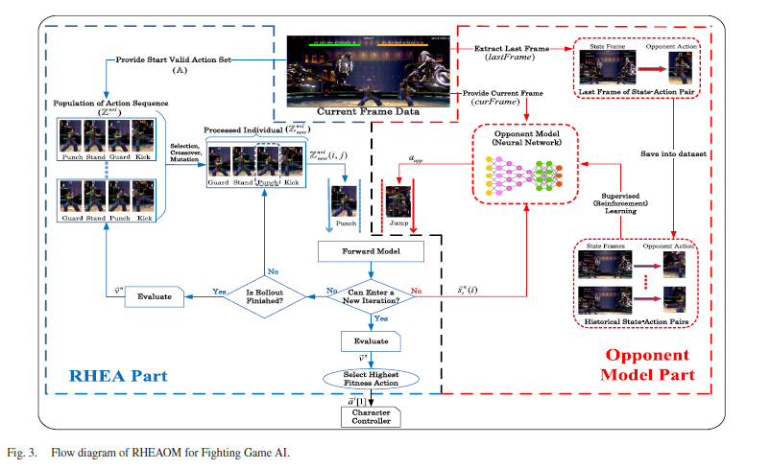

Slide 7
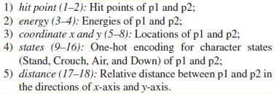
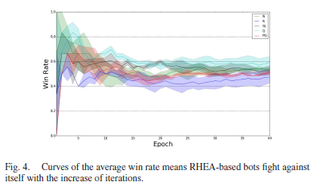
Methodology: Experimentation
Setup (Pts. 1-5)
FightingICE + RHEAOM
56 actions within 16.67 ms each w/ 15 frame latency
Utilizing only 3 characters for balance.
Fight until hp reaches 0 or 60s with most health remaining
Self-Comparison
Effect of random opponent model vs non opponent model
Verify the effect of different training rules
Observe winning converge efficiency (Fig. 4)
RHEAOM vs MCTSOM
Supervised learning and policy gradient best performing

Slide 8
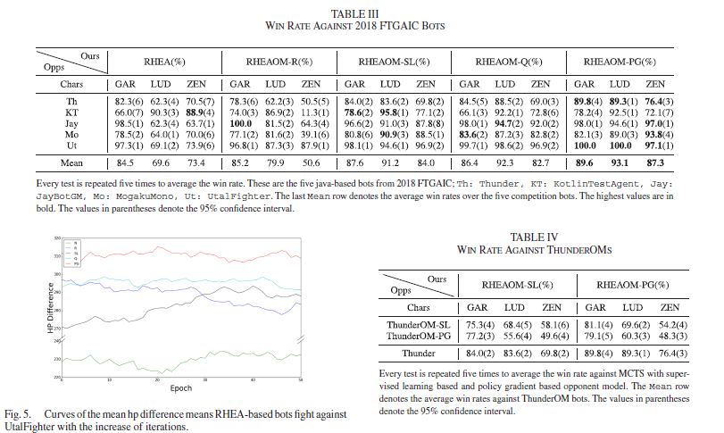

Slide 9
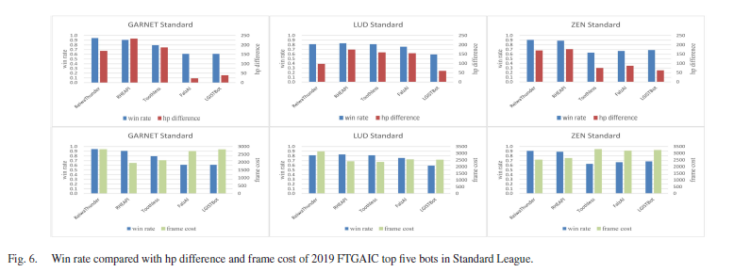
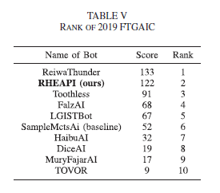
Results
FTGAIC 2019
RHEAPI (RHEAOM-PG) finished 2nd out of 10 bots
Fighting and speedrunning
Largest HP difference and lowest avg frame cost
Negative correlation between HP difference and frame cost

Slide 10
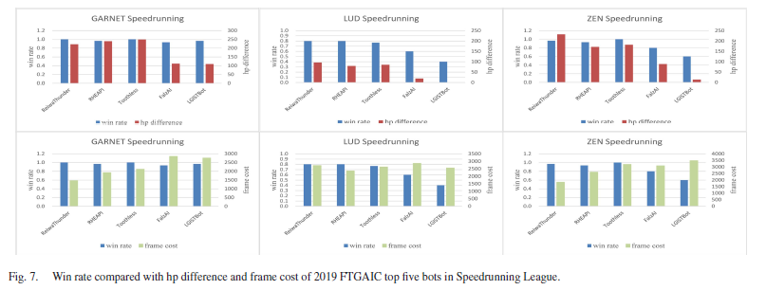
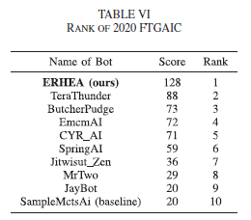
Results contd.
FTGAIC 2020
Improved upon the RHEAPI
Enriched opponent observation
Enhanced reward design
Enlarge batch size of state-action pair datasets
Introduced reliable forward model utilized by previous winner

Slide 11
Strengths & Weaknesses
Strengths
Very comprehensive data definitions
Lots of viable, diverse opponents
Multiple ways to measure effectiveness locally and in competition
Weaknesses
Some mathematical terms unclearly defined
No calculated results of individual population testing
Relatively small sample size in competitive rounds

Slide 12
Conclusion
Presentation of the RHEAOM AI
Outperform state-of-the-art MCTS-based fighting bots
Efficiently finds weaknesses in opponents
ERHEA managed to win in scored competition

Slide 13
Further Research
Cannot completely defeat all opponents utilizing MCTS
Potential for model-based DRL
OM depends heavily on opponent predictability
Restricted by real-time constraint
More generalized approach to real-time decision making

Slide 14
Bibliography
Tang, Z., Zhu, Y., Zhao, D., & Lucas, S. M. (2023). Enhanced Rolling Horizon Evolution Algorithm With Opponent Model Learning: Results for the Fighting Game AI Competition. IEEE Transactions on Games, 15(1), 5–15. https://doi.org/10.1109/TG.2020.3022698

